Slide 1

Fundamentals - I

Slide 2
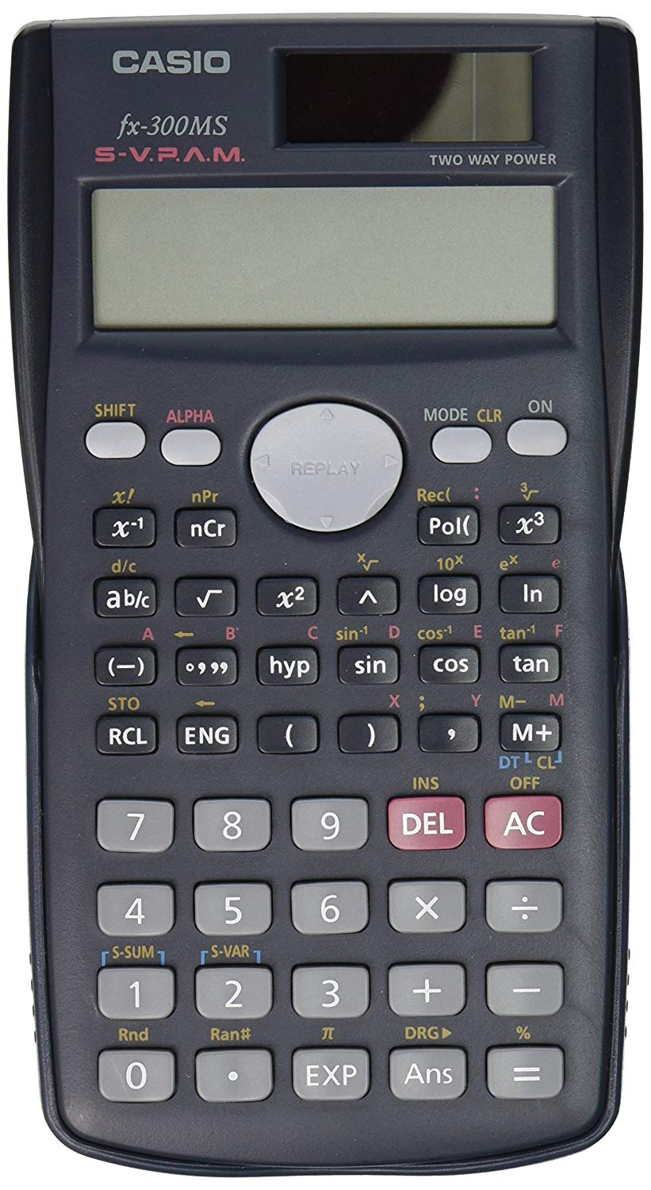
Basics (overview)
Input
5 + 10
15
Output
Assignment
Boolean and arithmetic operations
Conditionals
Repeats (a.k.a Loops)

Slide 3
Variables
Variables are like buckets that store values
Variable names can have (a-z, A-Z, 0-9, _)
Variables can be assigned with “=”
Python variables don’t care about types
Dynamic language
One variable can store single or multiple values (containers)
Examples: abc, Abc123, abc_def, _abcd all work, but not 123abc

Slide 4
Data Types
Basic data types
  Integer (int), e.g. 100, -50
  Float (float), e.g. 3.141, 2e10
  Boolean (bool), e.g. True, False
  etc.
Containers
  String (str), e.g. “Hello World!”
  List (list), e.g. [5,3.4, “This is a string”]
  Tuple (tuple), e.g. (2, 9.0, “This is another string”)
  Dictionary (dict), e.g. {“apple”: “red”, “banana”: “yellow”}
  etc.

Slide 5
Comments
Single-line comment (#)
# this is a comment
Multi-line comment (“””)
“””
This is a multi-line comment
... and it continues to the next line!
“””

Slide 6
Arithmetic Operation
Addition (2 + 3 = 5)
Subtraction (2 - 3 = -1)
Multiplication (2 * 3 = 6)
Division (2 / 3 = 0.67)
Modulo (5 % 3 = 2)
Power (3 ** 2 = 9)

Slide 7
Boolean Operation
Comparison Operators
  Equality (==), inequality (!=)
  Greater than (>), greater equals (>=)
  Lesser than (<), lesser equals (<=)
Logical Operators
  not
  and, or
  is,is not, in, not in

Slide 8
Conditionals
if something:
Do this
else:
Do that
if something:
Do this
elif some-other-thing:
Do that
else:
Do the other that
Note: instead of curly braces (like in C++) python uses spaces and indentations
The something here has to be a boolean

Slide 9
Loops
For Loop
fruits = [“apple”, “banana”, “orange”]
for fruit in fruits:
print(“I like”, fruit)
Result:
I like apple
I like banana
I like orange

Slide 10
Loops
range(from, to)
  range(5, 20)

Slide 11
Loops
While Loop
counter = 1
while counter < 4:
print(counter, “squared is”, counter ** 2)
counter = counter + 1
Result: 1 squared is 1
2 squared is 4
3 squared is 9

Slide 12
Loop modifiers
Break
  Break out of a loop immediately
  Once break is hit, any code after the statement is not executed for the current iteration
        # Use of break statement inside the loop
        for val in "string":
        if val == "i":
        break
        print(val)
        print("The end")

Slide 13
Loop modifiers
Continue
  Repeat the loop instantly
  Once continue is hit, any code after the statement is not executed for the current iteration
      # Program to show the use of continue statement inside loops
      for val in "string":
      if val == "i":
      continue
      print(val)
      print("The end")

